Slide 1
Group 2 Inertia Wheel Pendulum
Fall 2021 MECA 482
Dylan Palmer, Megan McKinney, Chris Mintz, Cole Brenner

Slide 2
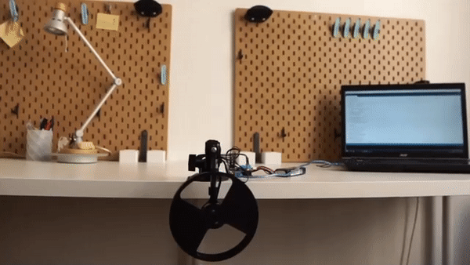
Introduction
An Inertia Wheel Pendulum(IWP) is a mechanism that utilizes an actuator to rotate a wheel and stabilize a pendulum in an upright position.
An electromechanical system that uses the wheel as a mass that creates a torque and causes a pendulum to react by rotating.
Used for educational and research purposes

Slide 3
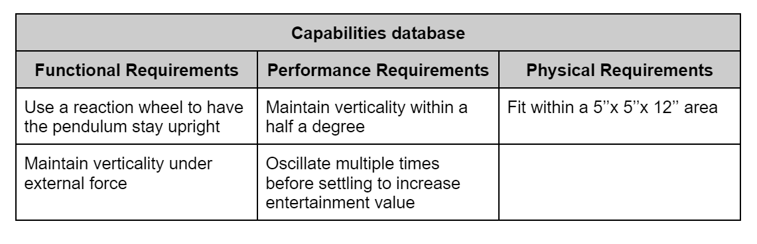
Requirements

Slide 4
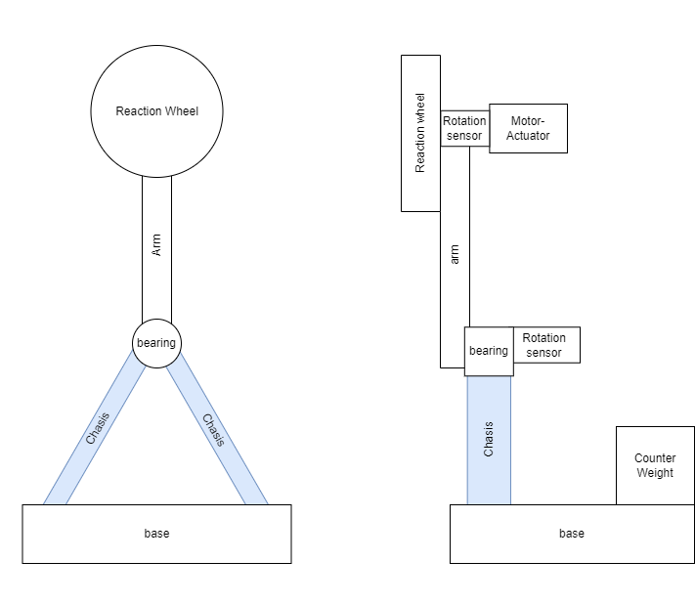
Operational Viewpoint Diagram

Slide 5
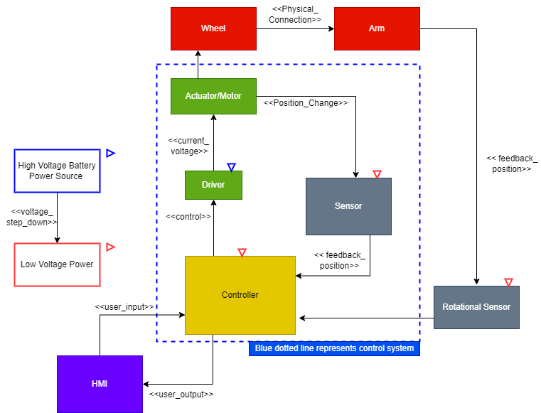
Logical/Functional Diagram

Slide 6
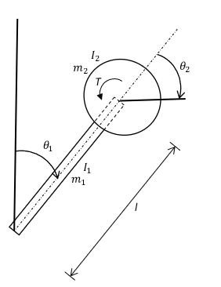
Mathematical Model
Mathematical model was derived using the Lagrangian method
Model has two degrees of freedom; one from the rotation of the arm and one from the rotation of the wheel
The model uses full-state feedback as the control algorithm
The constraints of the system were percent overshoot and settling time

Slide 7
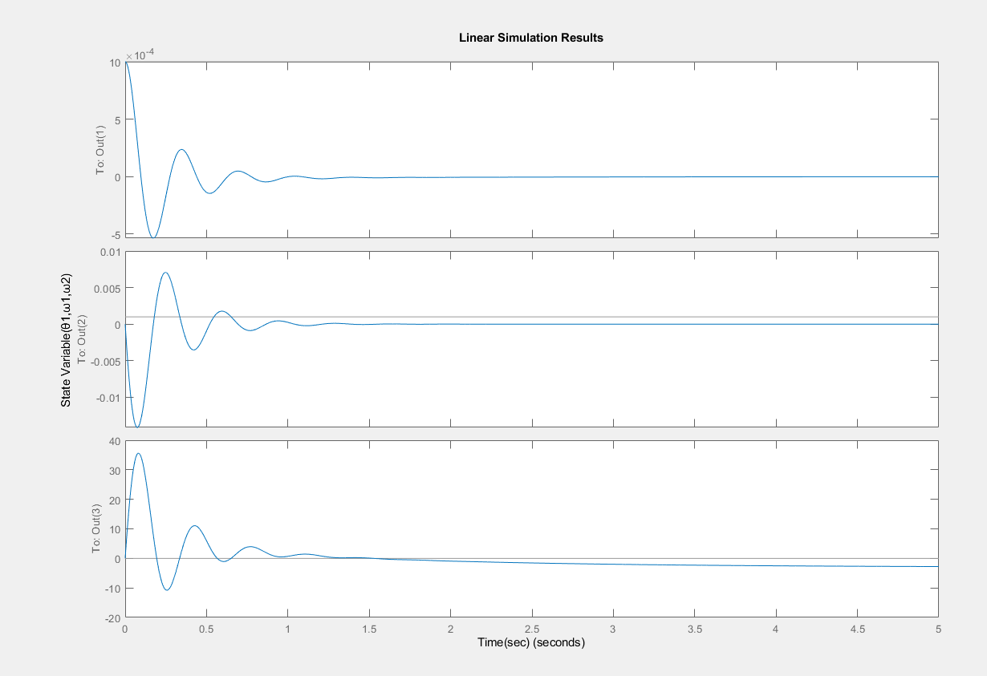
Matlab Simulation
Simulation oscillates multiple times per our capabilities database
Matches our settling time of one second, and our percent overshoot of fifty percent
These characteristics can be altered within the matlab code

Slide 8
Website
https://github.com/cdmintz/MECA-482-Inertial-Wheel-Pendulum

